Slide 1

BHARATI VIDYAPEETH’S INSTITUTE OF COMPUTER APPLICATIONS AND MANAGEMENT (BVICAM)
(GURU GOBIND SINGH INDRAPRASTHA UNIVERSITY)
NEW DELHI
April, 2021
MINOR PROJECT
NOTEPAD APPLICATION
Mentor- Dr.Vaishali Joshi
(Associate Professor)
Submitted by
Riya Kumari Kushwaha
Enroll No. 03735304420

Slide 2
Content
Introduction
Problem Statement
Proposed Solution
Use case diagram
Data Flow Diagram
Screenshots
Conclusion
Bibliography

Slide 3
Introduction
A text editor is a type of computer program that edits plain text. Such programs are sometimes known as "notepad" software, following the naming of Microsoft Notepad. Text editors are provided with operating systems and software development packages, and can be used to change files such as configuration files, documentation files and programming language source code.

Slide 4
Problem Description
To create a text editor similar to notepad.
Text Editor: - A text editor is a type of program used for editing plain text files. A plain text file is represented and edited by showing all the characters as they are present in the file. The only characters usable for 'mark-up' are the control characters of the used character set; in practice this is newline, tab and form feed. The most commonly used character set is ASCII, especially recently, as plain text files are more often being used for programming and configuration, and less frequently for documentation (e.g. detailed instructions, user guides) than in the past.

Slide 5
Proposed Solution
Features
Open – Opening a presaved files.
New – Creating a new file.
Save and Print – To save text files and converting it into pdf.
Copy,Cut, Paste,Undo,Redo and Select All – For copying and cutting a string of text , pasting and to select the entire text of the file.
Format- Changing text colour ,background colour and font of the text.

Slide 6
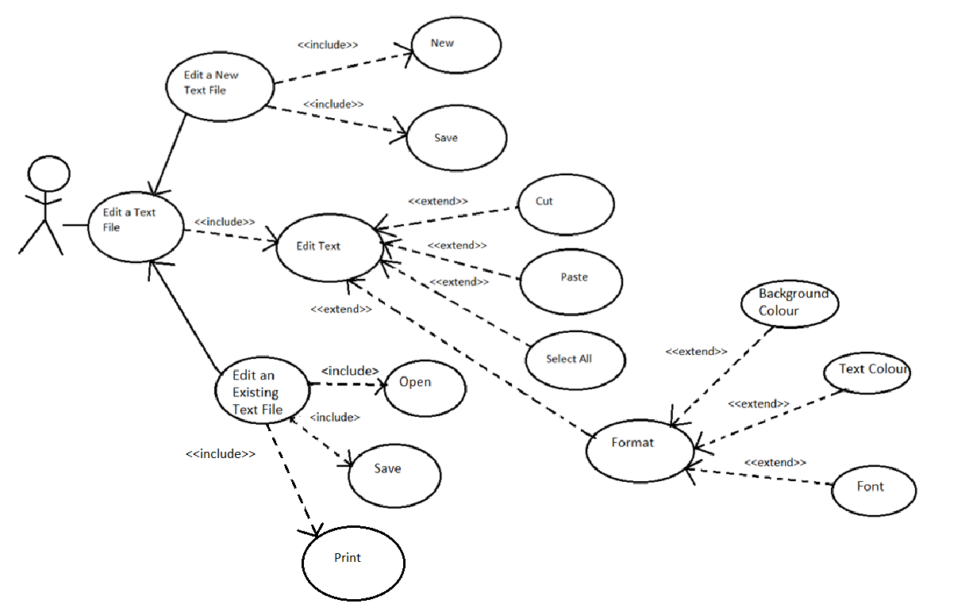
Use Case Diagram

Slide 7
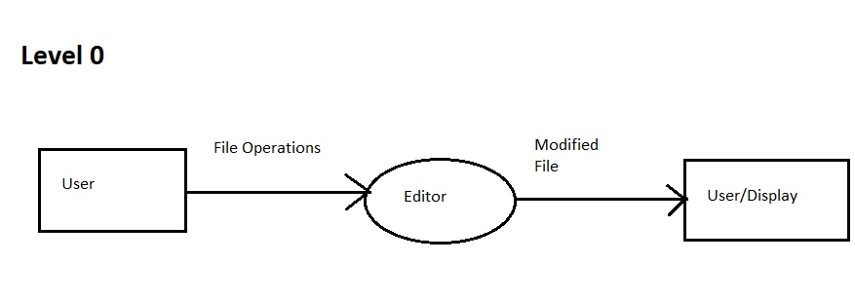
2. Data Flow Diagram

Slide 8
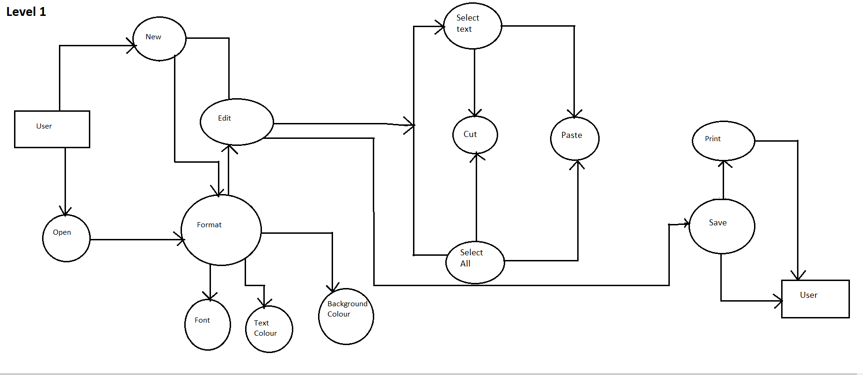

Slide 9
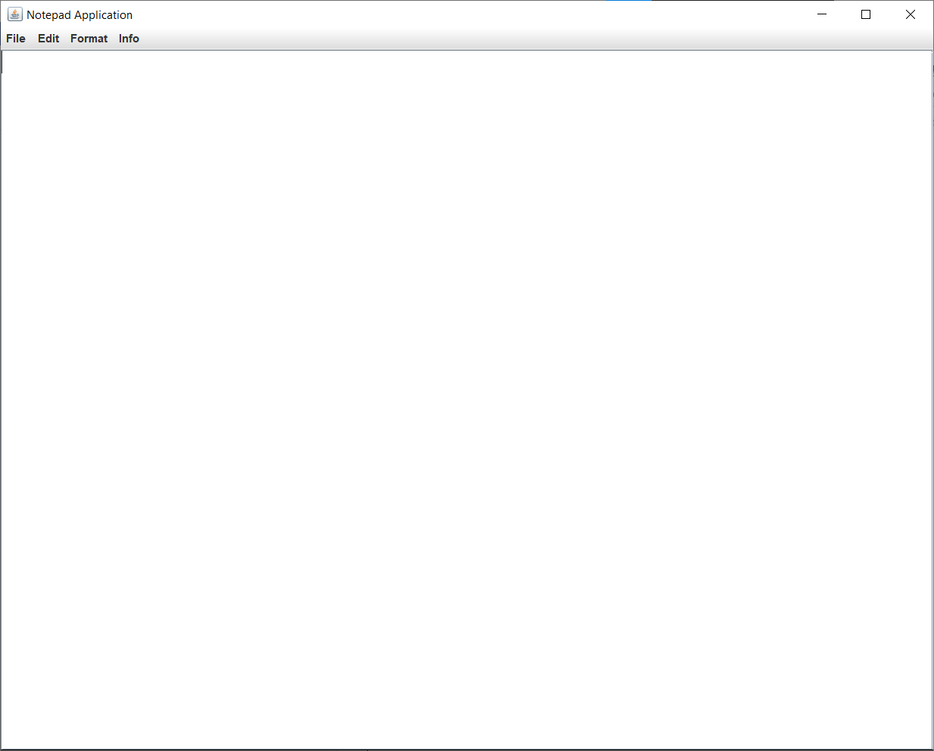
Screenshots of the running code
Main Window

Slide 10
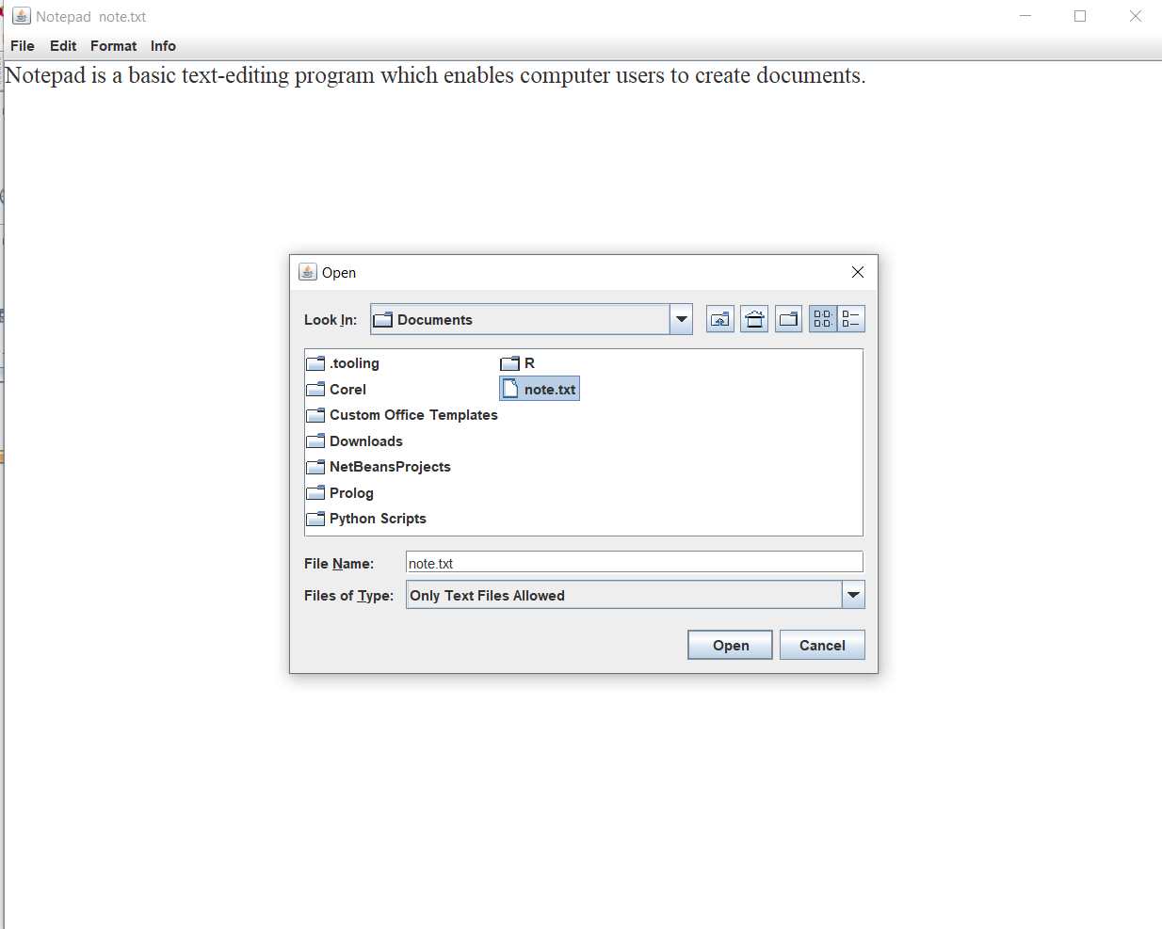
Opening a file

Slide 11
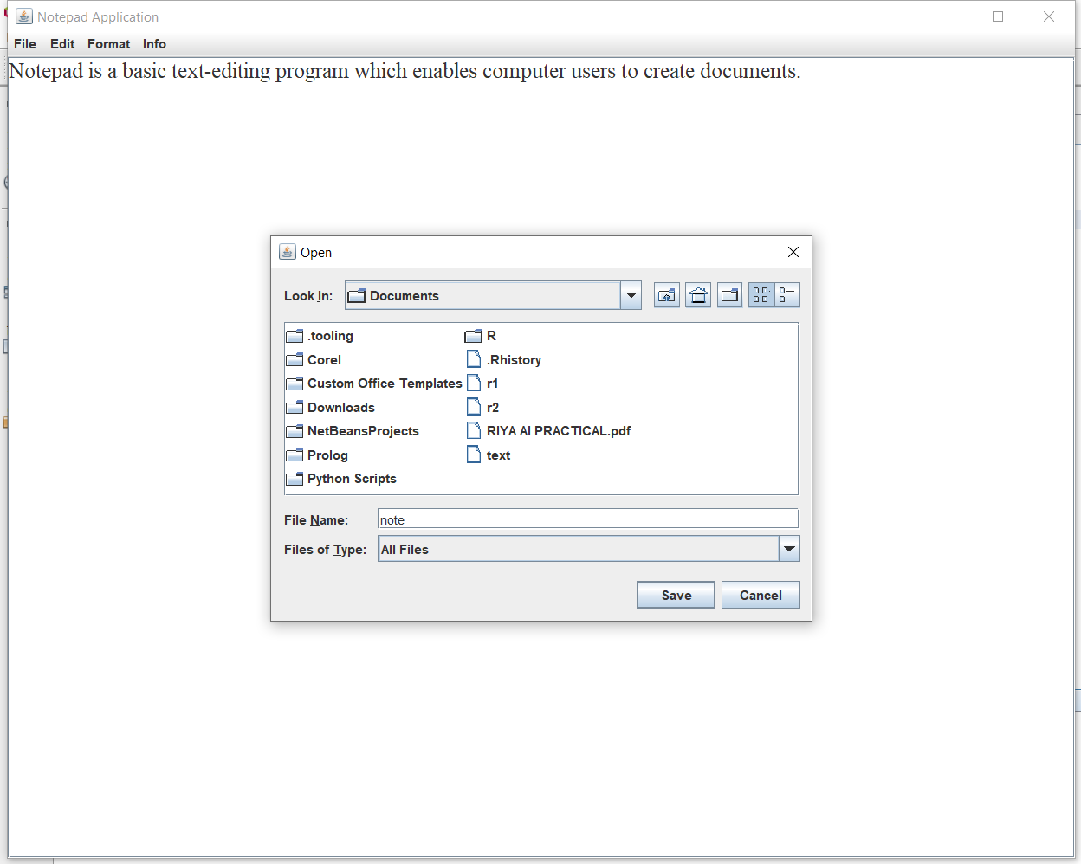
Saving a file

Slide 12
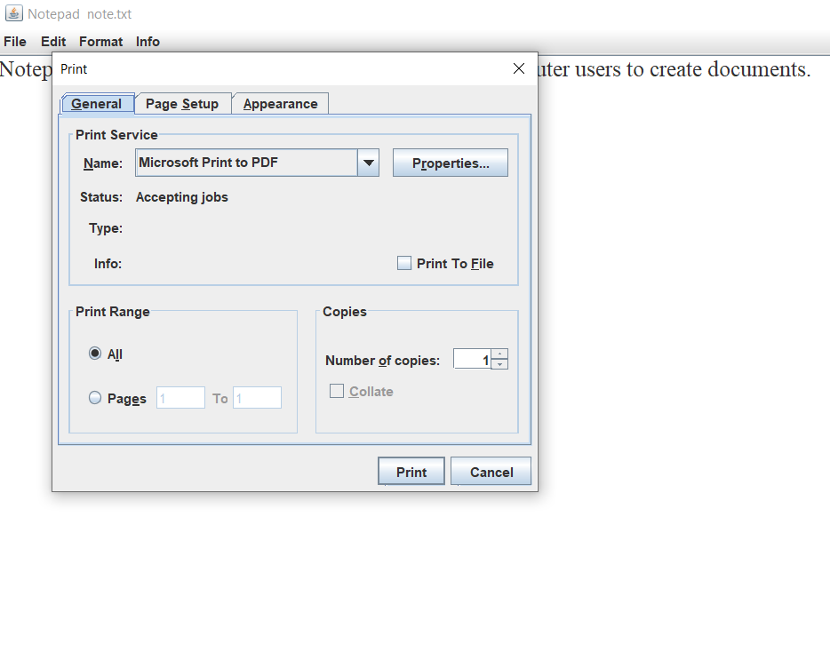
Print

Slide 13
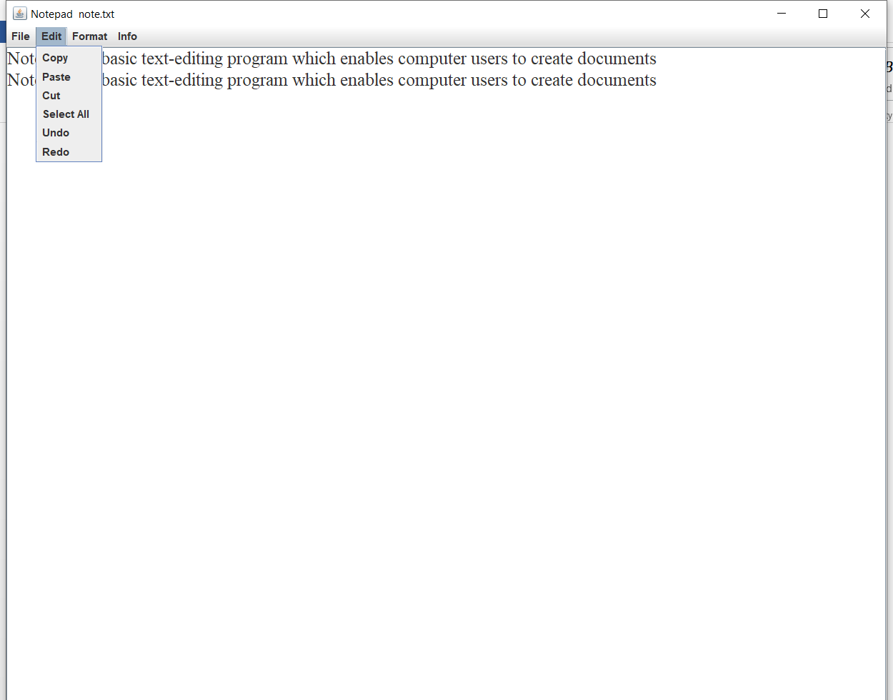
Edit Options

Slide 14
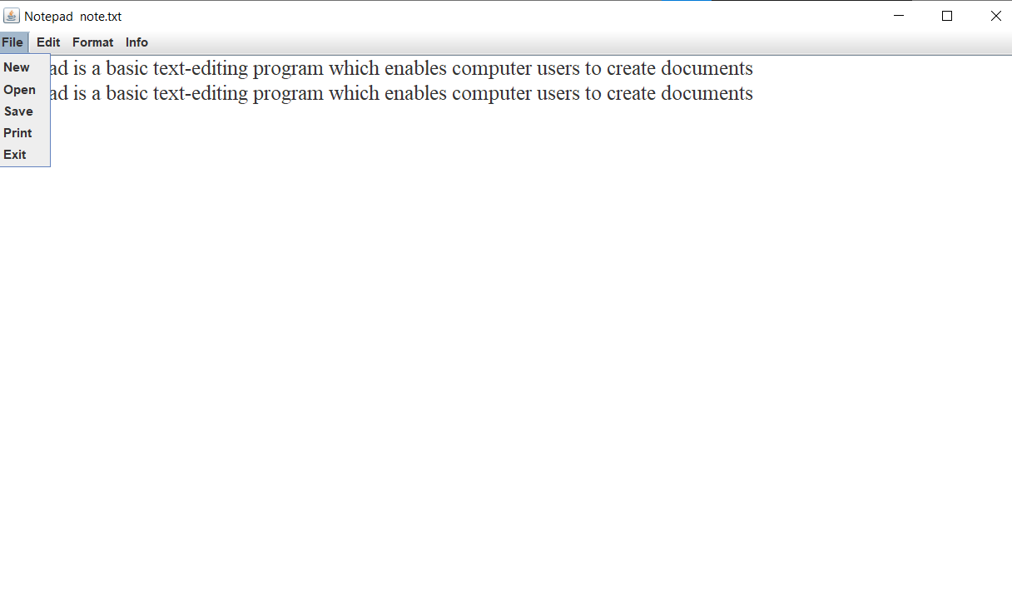
File Options

Slide 15
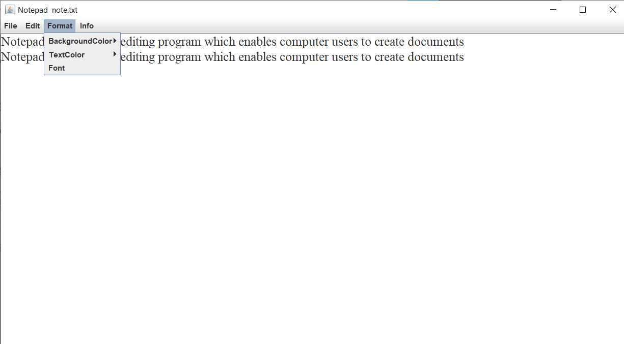
Format Options

Slide 16
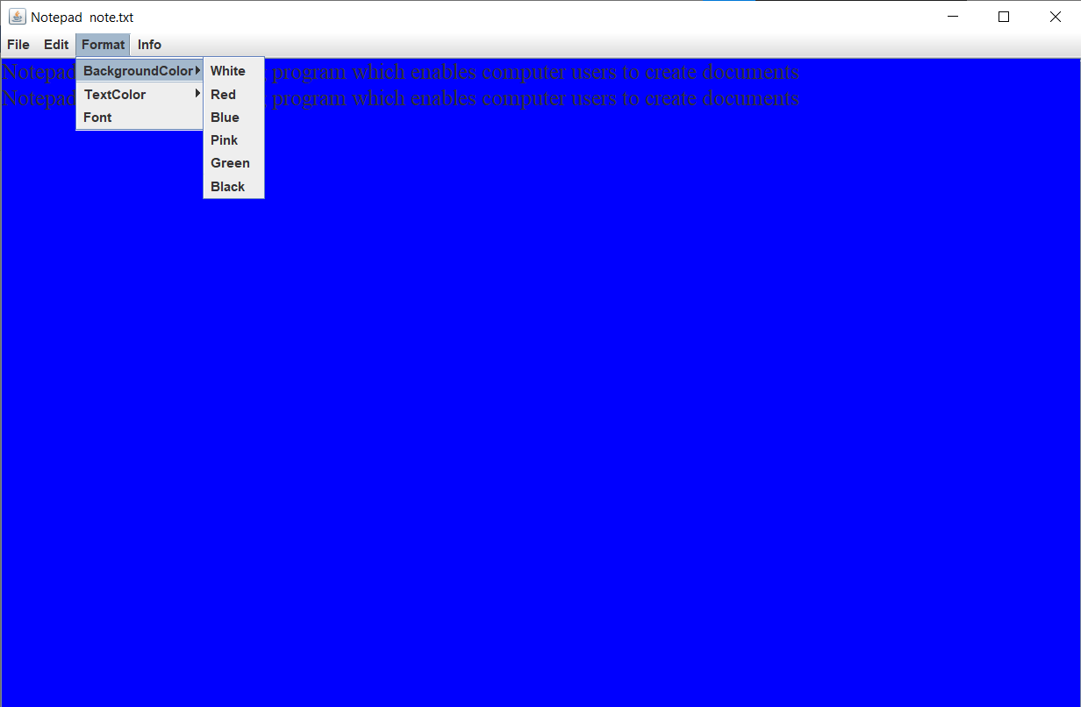
Background Colour Option

Slide 17
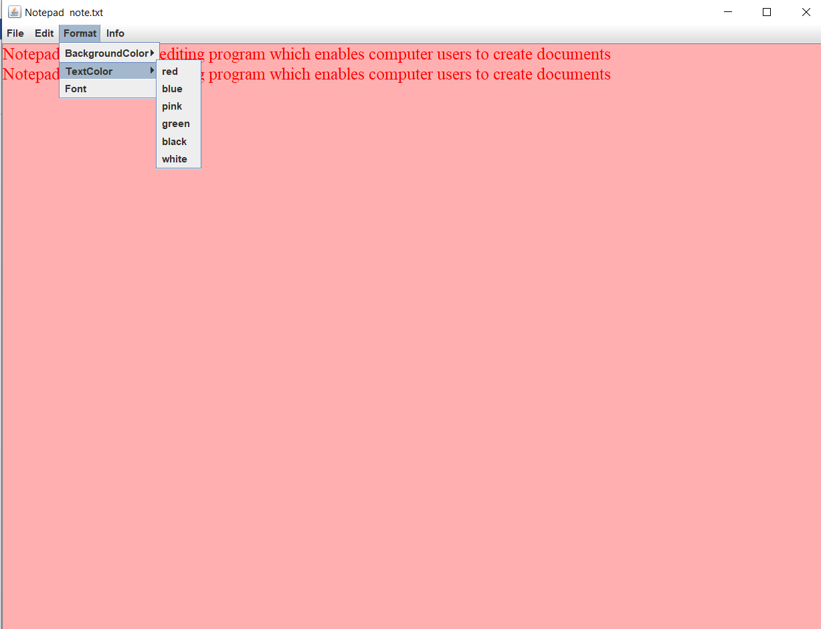
Text colour option

Slide 18
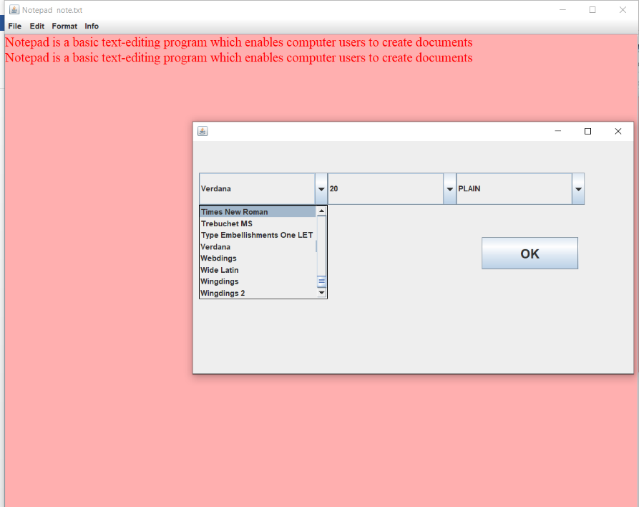
Font

Slide 19
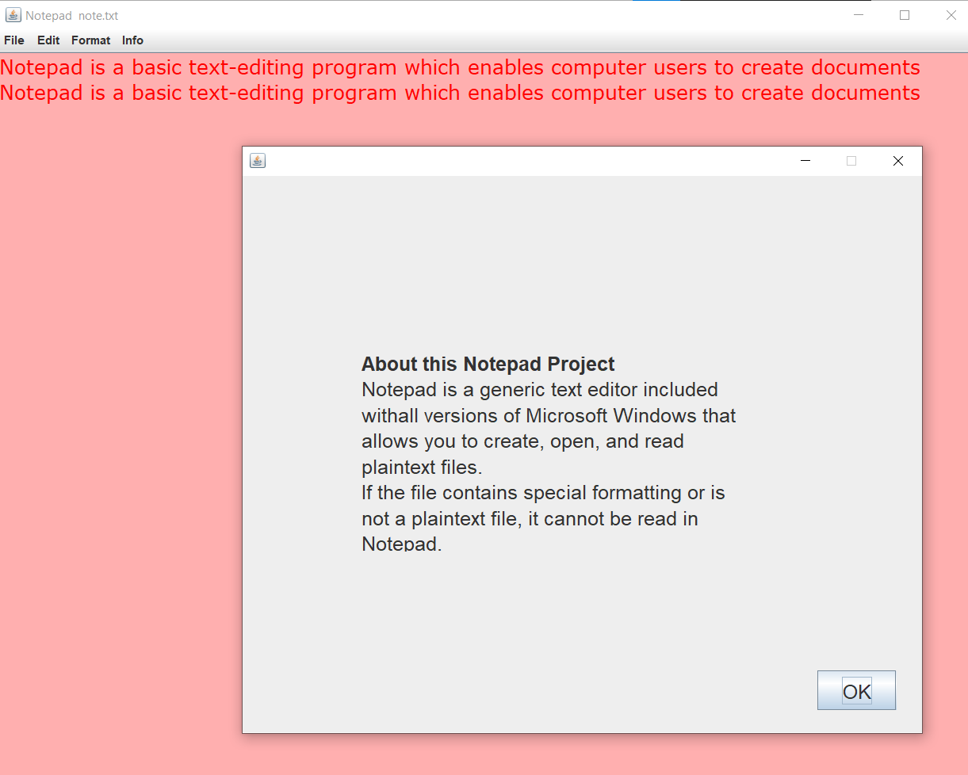
Info

Slide 20
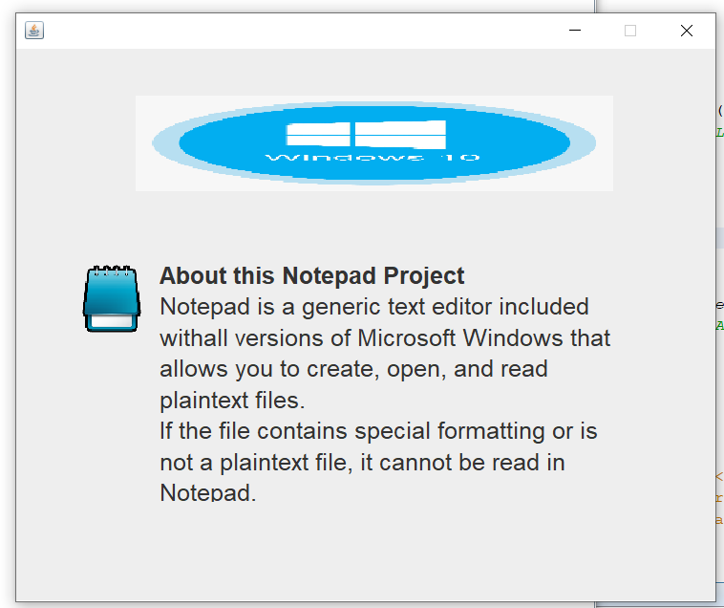
Info

Slide 21
Conclusion
This project that I undertook is a simple implementation of Java Swing features and created a plain text editor . We use plain text editor in our daily life to write an essay ,to take notes etc. Text editors make our work easier as we can read the saved notes notes , we don’t need pen and paper to write down.

Slide 22
Bibliography
The referred books were
Java 2-Complete reference (9th edition) by Herbert Schildt.
And the following websites were also used for reference
https://docs.oracle.com/javase/7/docs/api/java/awt/datatransfer
https://www.javatpoint.com/event-handling-in-java
https://www.tutorialspoint.com/java/io/java_io_file.htm
https://docs.oracle.com/javase/7/docs/api/java/io/PrintWriter.html

Slide 23
Thank You

